Slide 1



WELCOME!
Opportunities in
Forward Deployed Naval Forces (FDNF)
ship maintenance
…Globalize your career!
Notes:
Everyone in this room is a Ship Maintenance Professional. You fix ships!!
And hopefully you are here because you want to advance your career and continue to serve your country by maintaining the fleet.
If you love your job and have no desire to do or go anywhere else, then this brief is probably not for you.
If you hate your job and want to do ANYHTING else, then this information is probably not for you.
If you’re here because this is a chance to take a break from your job, then you’re probably not the person we are looking for.
If you fall into any of those categories, you may want to leave now.
If you want to “Globalize Your Career”, you’re in the right place.

Slide 2

Globalize Your Career!
Notes:
Option 2: DDG

Slide 3
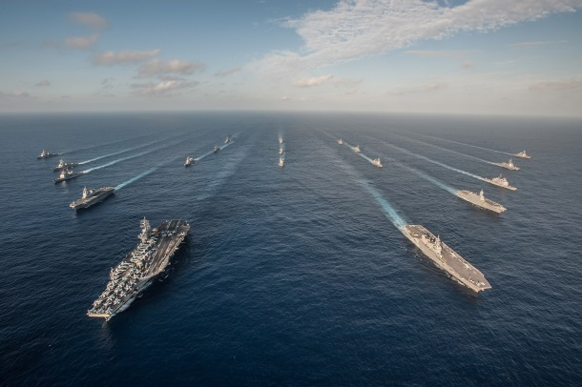
U.S. Navy Forward Deployed
…and we need folks to maintain them
Notes:
The US Navy has ships Forward Deployed (homeported) in Japan

Slide 4
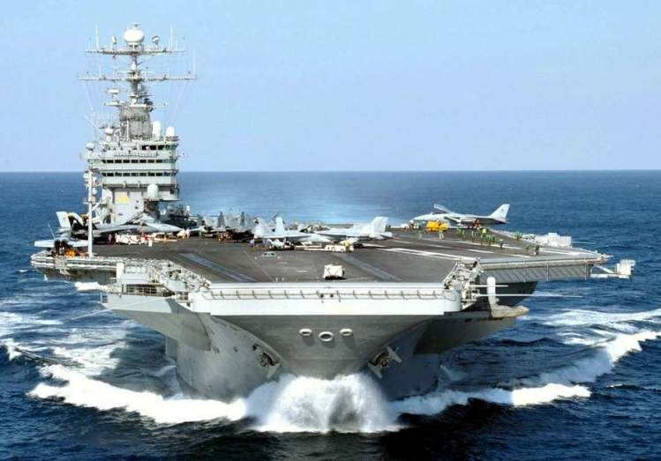
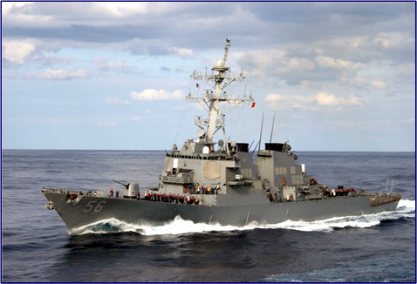
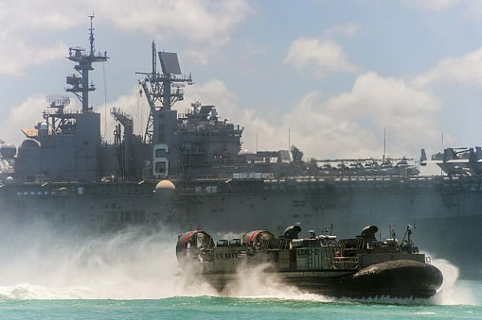
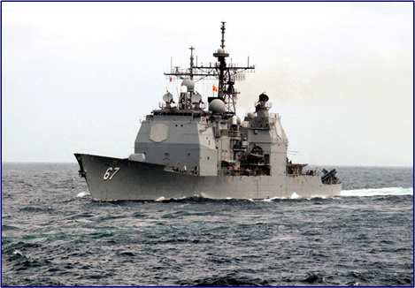
Forward Deployed ships
1 CVN
1 LHD
1 LCC
3 CGs
1 LPD
13 DDGs
2 LSDs
8 MCMs
10 PCs
…plus LCS rotations
1 FDNF ship = 3 US ships deploying
Notes:
The US Navy has ships Forward Deployed (homeported) in Japan

Slide 5
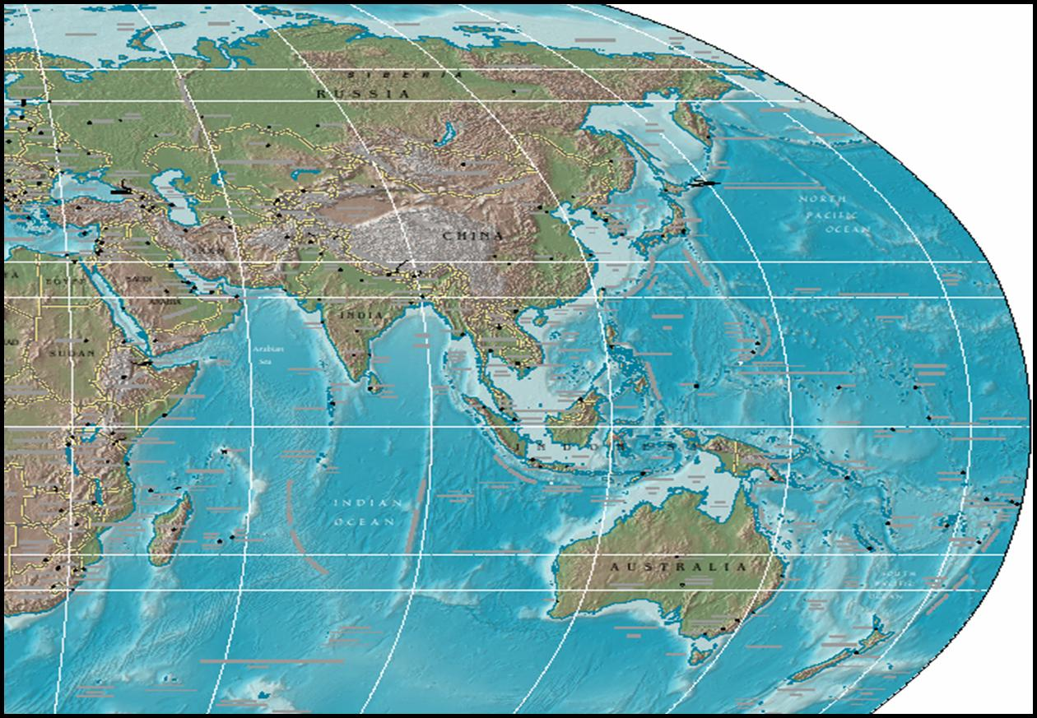
Forward Deployed Maintenance
Show map or list FDNF sites
FDRMC HQ Naples
SRF-JRMC Yokosuka
FDRMC DET Rota
PSNS&IMF Det Yokosuka
FDRMC DET Bahrain
SRF-JRMC DET Sasebo
~230 FDRMC positions
Over 400 Japan positions
Providing
Maintenance
Repair
Modernization
Fleet Tech Assist
Technical Authority
COMLOGWESTPAC
Strategically located
for the deployed Fleets
Notes:
We fix them where they serve!
Address why are they here
Address why we are here

Slide 6
The Navy Needs You
FACT:
We need people just like you
– Ship Maintenance Experts –
in our Forward Deployed ship maintenance activities
Globalize Your Career

Slide 7

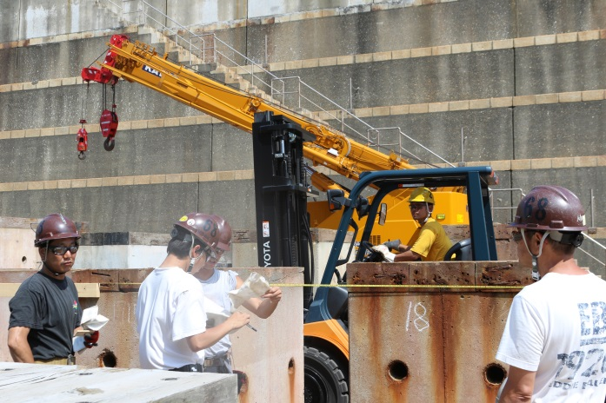
FDNF Workforce
Production oversite, specialists, techs, & supervisors
  SRF-JRMC Yoko: Japanese production workforce
    Small Japanese production shop in Sasebo
  CVN nuclear support: PSNS&IMF civilians
  Bahrain, Rota & Sasebo contract production work
US civil service positions
  Mostly GS-11 and above
  Project teams & support
  Technicians, engineers, etc
  Supervisors, managers, etc
Notes:
Tip of the Spear OPTEMPO means…
More maintenance, tighter time windows
Our pace is accelerated and that means…
Your career experience is accelerated
Our staff is smaller, and that means…
You get wider responsibility
Your professional development is broadened

Slide 8
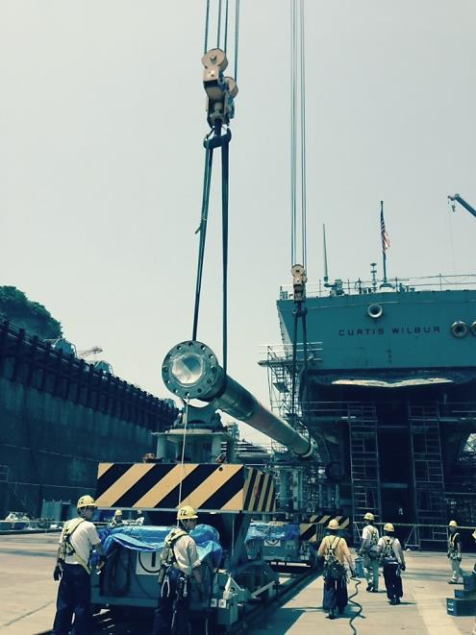

FDNF Maintenance
Tip of the spear ship maintenance
Waterfront operations
  High tempo
  High velocity throughput
  Immediate dividends
FDNF model
  Accelerated pace
  Your experience is accelerated
Notes:
Tip of the Spear OPTEMPO means…
More maintenance, tighter time windows
Our pace is accelerated and that means…
Your career experience is accelerated
Our staff is smaller, and that means…
You get wider responsibility
Your professional development is broadened
It’s what happens when you’re on the tip of the spear

Slide 9
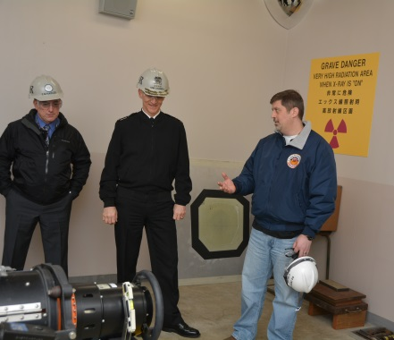
FDNF Challenges
High speed ➔ challenging
Deliver more in a tighter timeframe
Learn more, learn faster
More responsibility & authority
Advance your personal development
Advance your career
Notes:
Decision making at lower levels
Tip of the Spear OPTEMPO means…
More maintenance, tighter time windows
Our pace is accelerated and that means…
Your career experience is accelerated
Our staff is smaller, and that means…
You get wider responsibility
Your professional development is broadened

Slide 10
Career-enhancing Opportunities
“Senior level” experience
Leadership Development
  Supervisory & Project Management experience
  Communicating with diverse teams
  High levels of responsibility
Diversity
  Job assignments across multiple platforms
  Working across cultures and languages
Tip of the Spear Perspective
  Demanding FDNF environment
  Line of Sight to NAVSEA and CNRMC
Expand future career horizon
Rapidly improve
  Communication skills
  Professional skills & performance
  Promotion potential

Slide 11
Testimonials
“Almost everybody at SRF has a much broader range of duties and responsibilities than their stateside command.”
“At SRF, I've worked on four new classes of ships […] and familiarized myself with dozens of additional ships systems and components that I hadn't worked on in the states.”
“Everyone who works here will be a mentor and a leader. After only my second year working at SRF, I was given a mentor role.”
“Senior level positions open up every couple years, so promotion potential within FDNF is way higher than any stateside command.”
“It is not uncommon for folks to get hired into a promotion at FDNF, and then get promoted again after working at for a couple years. That kind of career advancement is virtually impossible in the states.”

Slide 12
Globalize Your Career
Quick list of top FAQs
Top 10 List…
Notes:
Yes, I am interested…
But what can I expect?
Here’s the Top 10 List of FAQs!

Slide 13
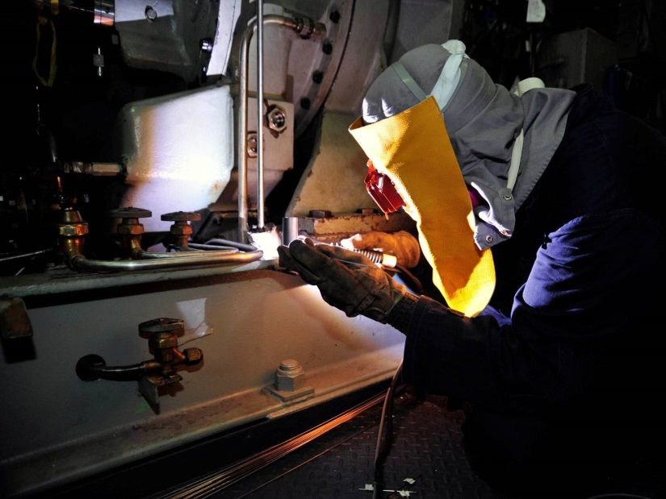
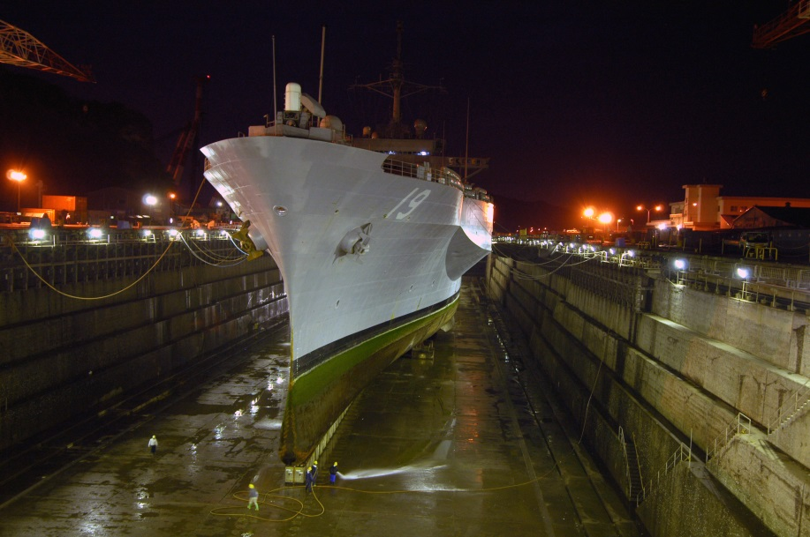
Top 10 List: FAQs
1. Is the work in FDNF challenging?

Slide 14
Top 10 List: FAQs
1. Is the work in FDNF challenging?
Yes, but very rewarding
Excellent for personal growth
Excellent for career development
An experience of a lifetime!

Slide 15

Top 10 List: FAQs
2. Length of Tour?

Slide 16
Top 10 List: FAQs
2. How long will I be overseas?
Your overseas tour is 3 years… except
  Bahrain is 18 months or 24 months
Some are invited to stay up 5 year limits
  DoD limits overseas tours to 5 years
  Waivers for “over 5” granted based on need
Return Rights retained through 5 Years
  May be extended further by your home command
Notes:
3-year obligation (except Bahrain)
Extensions to 5 years possible
Return Rights guaranteed through 5 Years
Creates need for continual replenishment of foreign deployed workforce
2 years stateside to “reset clock”

Slide 17




Top 10 List: FAQs
3. What do I do with my “stuff”?

Slide 18
Top 10 List: FAQs
3. What do I do with my “stuff”?
The Navy moves you, your family & your stuff –
  “PCS”: Permanent Change of Station
Temporary lodging & meals
Travel to PCS station
Household goods
  To PCS station
  Non-temporary storage
  Express shipment
Notes:
Plus your dog will be barking in Japanese in no time – maybe she’ll translate for you!
Good stuff to know: If you are going to bring a pet to Japan, start preparing now!

Slide 19
Top 10 List: FAQs
4. How’s the pay?
It’s great, but different than in the states…
Compensated for housing, utilities and provided a post allowance – all Federal tax free
You won’t lose money
Entitlements to offset the cost of your move*
* PCS entitlements are now taxable
As with all entitlements & benefits, you must qualify
IAW governing regs
Notes:
Housing & utilities paid!

Slide 20
“Overseas” Compensation
Post Allowance (PAL)*
  For cost of living overseas
Living Quarters Allowance (LQA)*
  Pays rent & utilities
Foreign Transfer Allowance (FTA)*
  Temporary Lodging before you leave
Temp Quarters Subsistence Allowance (TQSA)*
  Until you find a house/apartment
Miscellaneous Expense Allowance
  Move-in expenses
And more…
      * No Federal tax
Notes:
20
Mention no locality adjustment for working overseas
- Post Allowance (PAL)
For cost of living overseas
- Living Quarters Allowance (LQA)
Pays rent & utilities
- Foreign Transfer Allowance (FTA)
Temporary Lodging before you leave
- Temporary Quarters Subsistence Allowance (TQSA)
Until you find a house/apartment
- Miscellaneous Expense Allowance
Move-in expenses
- And more…
-----------------------------------------------------------------------
Good Benefits Package for overseas positions
Financial compensation for relocating to Japan
---------------------------------------------------
Relocation Incentive Bonus (Pay)
All positions may be eligible
Up to 25% of base pay per year for 3 years
Additional 25% years for extending
Dependent on position, i.e. criticality, difficulty to fill, etc

Slide 21
Other “Overseas” Incentives
“Full” base privileges
Leave Benefits
  Can carry over up to 360 hrs/yr
  Allowed to retain on the books when you return
  Home Leave after 24-mos continuous service abroad
    Accumulates at 5 days/year (10 days in Bahrain)
Renewal Agreement Travel (RAT)
  Roundtrip travel to states for entire family
  After first tour
  Every two years thereafter
POV Shipment
Incentives – based on position & criticality

Slide 22
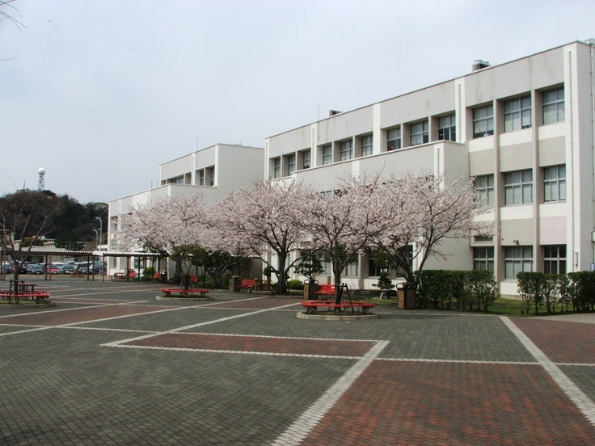
Top 10 List: FAQs
5. Where do my kids go to school?

Slide 23
Top 10 List: FAQs
5. Where do my kids go to school?
CDC – Child Development Center
Great on-base DoD schools, K-12
Colleges on-base
Private schools off-base (English and Local)
College kids in the US? – Paid student travel once per year

Slide 24
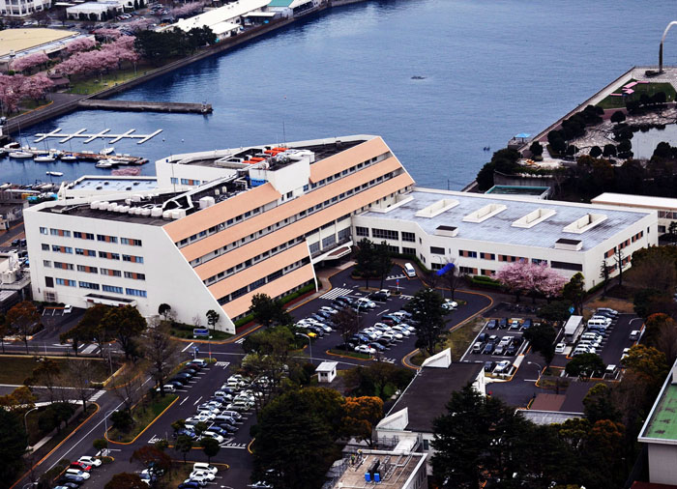
Top 10 List: FAQs
6. What about medical care?

Slide 25
Top 10 List: FAQs
6. What about medical care?
Employees may use base facilities – may be ‘space available’
  Except Bahrain (no military hospital)
Good local facilities – translator provided
  Paid travel to US for major care unavailable locally
  Base & locals require health insurance or bear full cost
  You are required to manage/file your own insurance
  All upfront cost typically paid by the employee
Base Dental care is space available
Good US-trained dentists available at all locations
Notes:
“Overseas” medical insurance required
Need to go outside the gate for dental – US trained dentists available

Slide 26

Top 10 List: FAQs
7. How far away will I be?

Slide 27
Top 10 List: FAQs
7. How far away are the areas?
A day or less away – by air all locations
Longer for some than others
All locations are convenient to airports

Slide 28




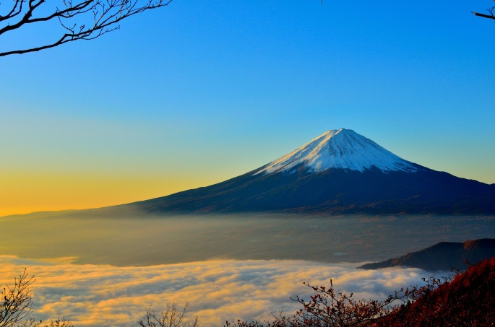


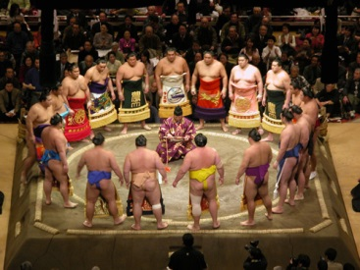




Top 10 List: FAQs
8. What can I do “outside the gate”?

Slide 29
Top 10 List: FAQs
8. What can I do “outside the gate”?
Shop, eat & see Europe, Middle East and Japan and Asia Pacific
Visit, shop eat & see the world
Experience “living on the economy”
Make Local National friends
Enjoy local culture, festivals & more
Hike, ski, scuba, climb & more
Lots of MWR/ITT & USO tours available

Slide 30
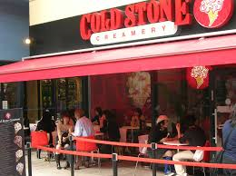
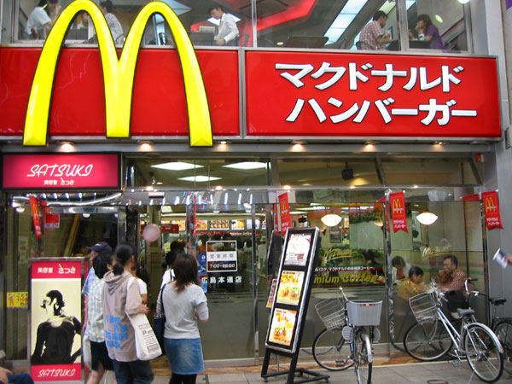

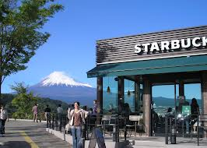




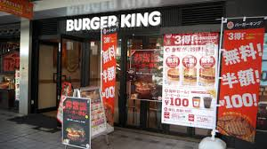

Top 10 List: FAQs
9. What if I miss the “creature comforts” of home?

Slide 31
Top 10 List: FAQs
9. What if I miss the “creature comforts” of home?
Many “creature comforts” on-base & off
Your tour will be over before you know it
  Explore the world while you have a chance
  Visit “home” – annual & home leave

Slide 32

Top 10 List: FAQs
10. Where do I shop?

Slide 33
Top 10 List: Japan FAQs
10. Where do I shop?
On-base: Commissary & exchange
Off-base: Lots of great shopping
Best of both worlds!
Same applies for restaurants
Need more? Take a quick flight to Europe, Korea, Hong Kong…
On line Internet shopping from all your favorite stores & USPS delivers to your base post box…

Slide 34



Bonus FAQ
11. Can I bring my pet?
If your pet is a dog, cat, etc – yes
If your pet is a pony – no
But start now – ensure you know the requirements
to complete customs entry!

Slide 35

Opportunity of a Lifetime!
Generous compensation package
Full base privileges provided
Wide range of support services/assistance
Be part of the FDNF Family - committed to:
  Japan – Keeping 7TH Fleet operationally ready
  Bahrain – 5TH Fleet
  Naples – 5TH & 6TH Fleets
  Rota – 6TH Fleet
  Enhancing the US-Host Nations & International Relationships
  Enjoying the safety & freedom overseas

Slide 36

FDNF Jobs
Over 600 “overseas” positions & growing including:
  Project Teams
  including CVN
  Fleet Tech Support
  Project Management
  Industrial Support
  Business Office
  Lifting & Handling
  Production Control
  Financial Mgmt
  Engineering
  QA
  ESH
  Combat Systems
  Electronics
  IT
  Logistics
  …and more
Typically 150+ job openings every year…

Slide 37
Globalize Your Career
TIME TO MAKE YOUR MOVE!!!

Slide 38
Start Globalizing Your Career
Rota, Naples & Bahrain Tours POC -
Xenia.Dean@eu.navy.mil
  Watch for our Website opening soon
Japan Tours Website (SRF & PSNS Det)
  http://www.navsea.navy.mil/Home/RMC/
  SRFJRMC/JapanTours.aspx
  www.srf.navy.mil or jobs@srf.navy.mil
  Visit our Facebook site for latest job openings
  SRF-JRMC: Linchpin of the Pacific Video
  - https://youtu.be/sq0SHrF9VzU
Other sources include
  USAJOBS
  Base Websites for each location

Slide 39
Opportunity of a Lifetime…
Globalize Your Career!
Join the FDNF team making a difference for today and tomorrow
Be part of the solution
Give your career a jump start today
Set up notifications for positions on USAJOBs:
https://www.usajobs.gov/Help/how-to/search/save/
https://www.usajobs.gov/Help/faq/search/job/not-posted/
Notes:
Japan is a beautiful country! But we also have a mission, we are asking you to take part in this mission.
The best source of information is what we call the “One Stop Shop” and is a webpage hosted by SRF-JRMC that will link you to opportunities in Japan and useful information for those accepting, or considering, a job in Japan.
You can also go directly to the USA Jobs site. (Opportunity to show the video, “Happy in Yokosuka”)

Slide 40
Globalize Your Career!
QUESTIONS

Slide 41

WELCOME!
Back-up Slides
…Globalize your career!
Notes:
Everyone in this room is a Ship Maintenance Professional. You fix ships!!
And hopefully you are here because you want to advance your career and continue to serve your country by maintaining the fleet.
If you love your job and have no desire to do or go anywhere else, then this brief is probably not for you.
If you hate your job and want to do ANYHTING else, then this information is probably not for you.
If you’re here because this is a chance to take a break from your job, then you’re probably not the person we are looking for.
If you fall into any of those categories, you may want to leave now.
If you want to “Globalize Your Career”, you’re in the right place.

Slide 42
Career-enhancing Opportunities
“Senior level” experience
Supervisory
Project Management
Large amount of responsibility
NAVSEA Line of Sight for SYD pers/CRMC for RMC
Diversity in exposure to multiple platforms
Demanding FDNF environment
Expanding future career horizons
Diverse workforce
Improve your communication skills faster
Build your leadership skills faster
Develop performance-improving kills
Boost your promotion potential
Diverse fast pasted opportunities to bridge your talents into areas of career growth

Slide 43
Employment Incentives
Post Allowance (PAL) – TAX FREE
  Based on Salary and number of dependents
  Ranges from: $8,000-$18,000 per year
Housing Allowance (LQA) – TAX FREE
  Based on Pay grade and dependents
  Roughly $43,600-$66,300 per year (depending on location)
Leave Benefits
  Can carry over up to 360 hrs/yr
  Allowed to retain on the books when you return
  Home Leave available after 24-months of continuous service abroad
    Accumulates at 5 days/year
Renewal Agreement Travel (RAT)
  Roundtrip travel to states for entire family
  After first tour
  Every two years thereafter

Slide 44
Extra Pay and Allowances
What do you get when overseas?
  Post Allowance* (TAX FREE) is not a direct % it is based on spendable income.
    Differs by location (Examples are for a GS-12)
      Naples 20%
      Rota 10%
      Bahrain 20% (about 10% of pay)
      Japan 25%
  LQA
    Differs by location (Examples are for a GS-12)
      Naples $43,200
      Rota $33,300
      Bahrain $47,300
      Sasebo $32,500
      Yokosuka $45,700
  Post Differential Bahrain Only 15%
  Sunday Premium Bahrain Only 25% = 2 hrs = 5% of 40 hrs (so it is 5% of base)
*Post allowance % differ by location and can be found on
the State Dept website https://www.state.gov/m/fsi/tc/31361.htm

Slide 45
So What Does This Mean
Bahrain Costs
  Average utilities $0 (Covered by LQA)
  Cable and Internet $0 (Covered by LQA) ➔ Bahrain only
  Commute Cost $50 (Gas and Auto miles month)
  Out Of Pocket Rent $0
    Total $50
Norfolk Costs
  Average utilities $200
  Cable and Internet $100
  Commute Cost $400 (Gas and Auto miles month)
  Out Of Pocket Rent $1000
    Total $1700
These represent low figures for Norfolk.
70K base pay in Norfolk: 80k -20,400 (annual out of pocket) $59,600 spending money
70K base pay in Bahrain: 91K -600 (annual out of pocket) $90,400 spending money
This means you have approximately 30K extra per year before OT

Slide 46
Employment Incentives
Storage and shipment of Household goods (HHG)
  Up to 18000 pounds HHG shipped at government expense
  HHG not taken to Japan stored at gov’t expense, except POV
Property Management Services Paid
  Let a Professional rent/lease and manage your home
POV Shipment allowed, but not necessary
  Will incur out-of-pocket expenses
Incentives available based on position and criticality
  Up to 25% of base pay
Foreign Travel Allowance (FTA)
  Allowance for temporary quarters before departing for overseas travel
Relocation Income Tax Allowance (RITA)
  Reimbursement of additional Federal, State & local taxes incurred as a result of payments for moving
Moving Expenses Allowance (MEA)
  Reimbursement of miscellaneous expenses

Slide 47
PSNS Det Yokosuka Jobs
75 USCS positions including
  Nuclear Engineers
  Engineers (various)
  Engineering Techs (various)
  Health Physicists/RAD Engineering
  QA Specialist
  ESH Manager
  Supply Manager
  Trade Supervisors & Leaders
  Material Expeditors
  Production Shop Planners

Slide 48
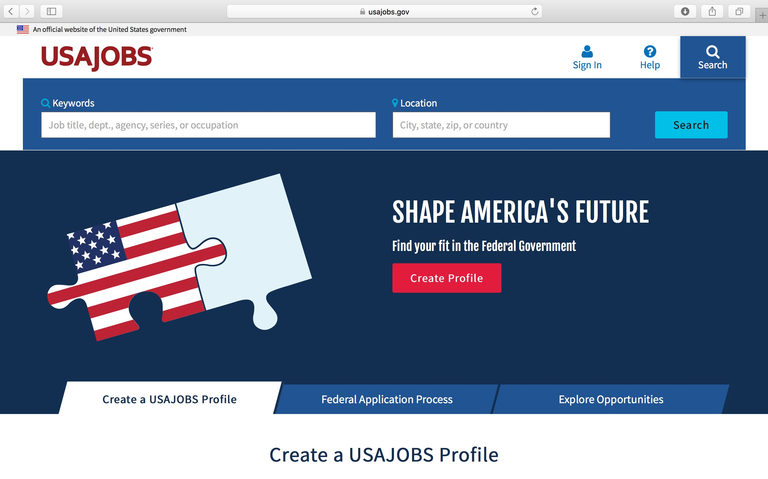
Must have a USA Jobs account to apply to competitive Federal positions
usajobs.gov

Slide 49
Applicant Eligibility Documentation Change
All applicants are required to submit both eligibility and qualification supporting documentation WITH the employment application.
This change will impact any individual that will be applying to US civil service positions via the Federal Government's official jobs site USAJOBS.
Lack of documentation and inability of the Office of Civilian Human Resources to make an appointment eligibility will result in non-referral for the position.
All DON announcements will identify the required documentation.
Internal and external recruitments will have the same process.
Status candidates (including DON employees) must submit supporting documentation (e.g. SF-50, Transcripts, etc.) to support the claims made in the application.
Utilize the most current pay SF-50 (as opposed to an award action or other non-pay action) in addition to any other pertinent SF-50s to substantiate time-in-grade and/or specialized experience in a specific job series.

Slide 50
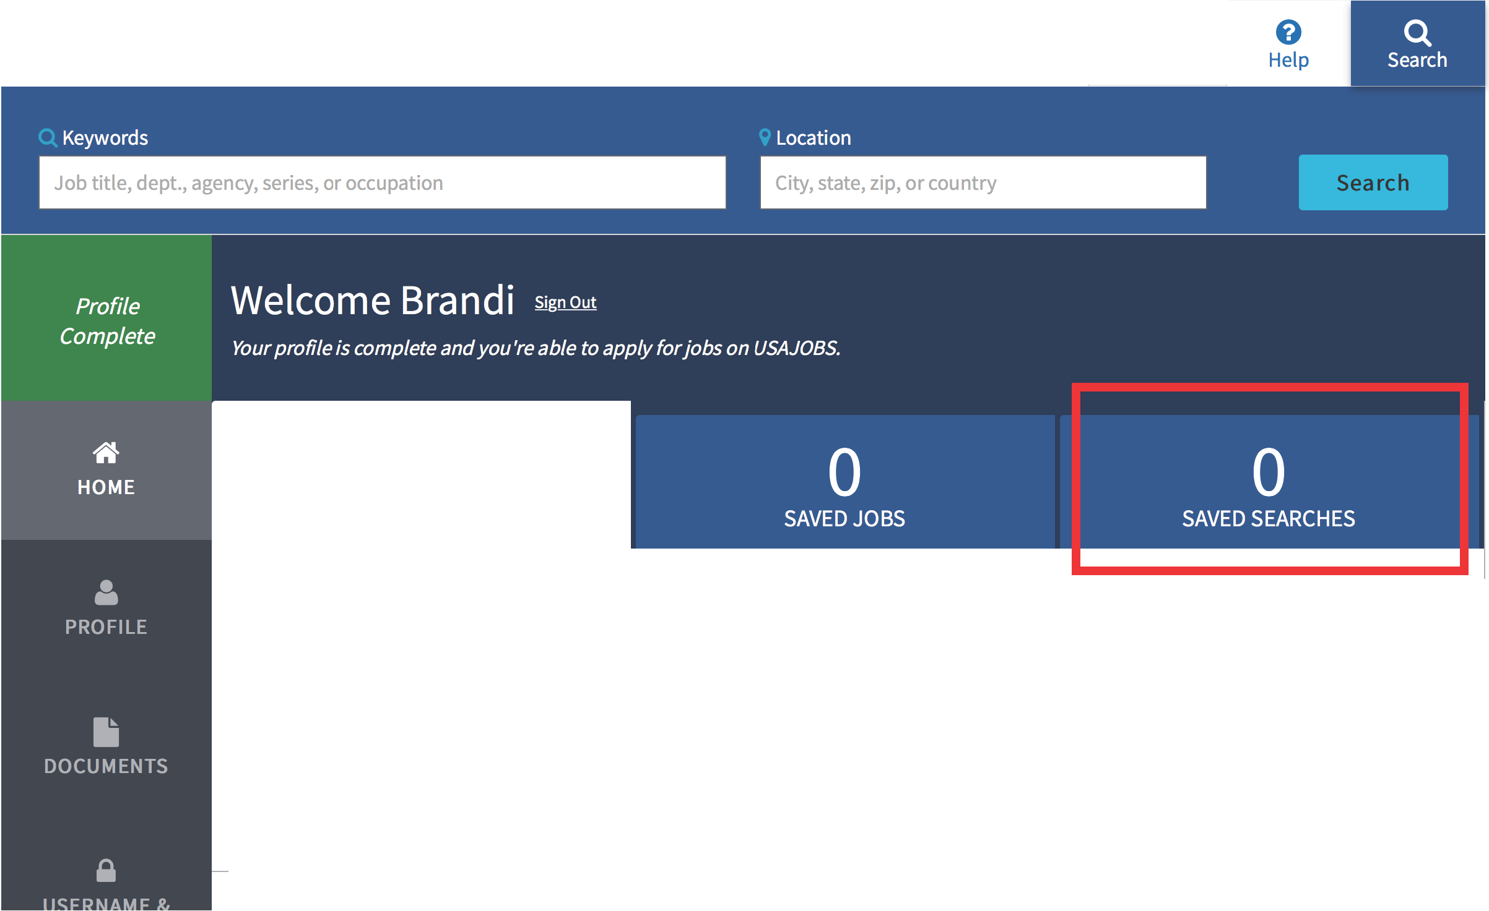
1111§ An official website of the United States government
_. 1
Brandi
USAJOBs·
13
APPLICATIONS
Active
Archived
Fi nd & filter a P-P-lications
+
Sort by I Last updated
v
0 Notifications

Slide 51
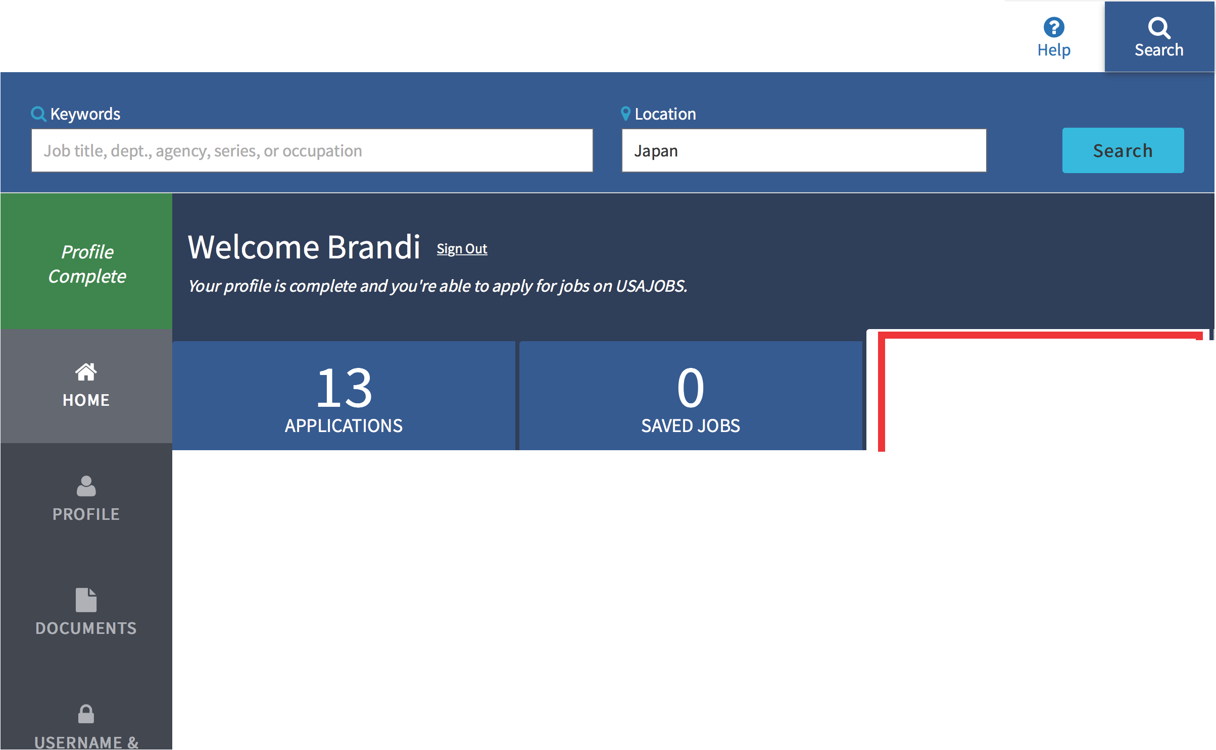
11111§ An official website of the United States government
.a. I
Bra ndi
USAJOBs·
0
SAVED SEARCHES
Active
Archived
Begin your job search
I
Q. Keywords
9 Location J_o_b_t_it_le_,_d_ep_t_.,_a_g_e_n_cy_,_s_er_i_es_,_o_r _o_cc_u_p_a_ti_o_n
₁ I Japan
Search
--------------.:.......;;;;;;;;;;;;=...11
To save a search select the Save This Search button on the search results page.

Slide 52
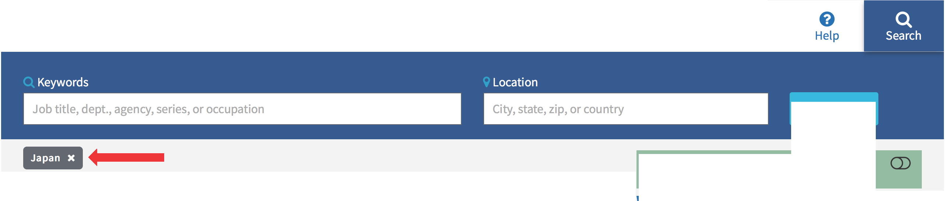
An official website of the United States government
:.
Brandi
USAJOBs·
Search
& You're nolonger usingfilters from your profilefor this search.
X Remove all filters
IViewing 1- 10 of 115 jobs
I
Sort by I Relevance v
Top filters
More filters
111111 Save this search. We'll email you newjobs as they become available.
Hiring path
9Help
PROGRAM MANAGER
U.S. Navy - Agency Wide Department of the Navy
Multiple Locations
{;[ Save Job
Select all
aOpen to the public (79)
8 Federal employees (61)
Startingat $32,318 (GS 05-07) Permanent • Full Time
0
0
eInternal to an agency (14)
0
0Open 11/10/2016to 09/30/2017
₀ 0Veterans (29)
SCIENTIST
U.S. Navy - Agency Wide Department of the Navy
Multiple Locations
{;[ Save Job
0
6) Individuals with disabilities (19)
Startingat $48,968 (GS 09-13) Permanent • Full Time
₀ 0 Former overseas employees (3)
0
Military spouses (48)
Show oi:itions with O jobs
-·- -·- .. .. ,.,,.. ,....,..., ,.. .L _ "'""'....,.... .......... ....,

Slide 53


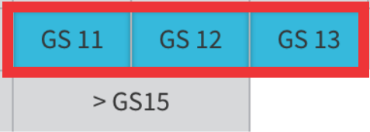
I Pay
I
@ Help
Department & Agency
X
Top filters
IHiring path
More filters
Q Salary
$0
I
Department Agency
9Help
$500,000
9 Help
$60,210 (min GS 11) - $111,56( (max GS 13)
Jump to
a eFederal employees (16)
Reset
A B c D E F G H
N O P Q R S T U V
J
K L M
(j) Grade
W X Y Z
O o Internal to an agency (6)
O (J» Veterans (15)
0 0 Individuals with disabilities (1)
< GSl
GS l
GS 2
GS 3
GS 4
Show O[ltions with O jobs
GS 5
GS 6
GS 7
GS B
GS 9
A
0 Department of the Air Force (7)
0 Department of the Army (1)
0
Military spouses (16)
GS lO
GS14
Show O[ltions with O jobs
GS15
General Schedule {GS) equivalent
D
O Department of Defense (30)
N
a Department of the Navy (16)

Slide 54
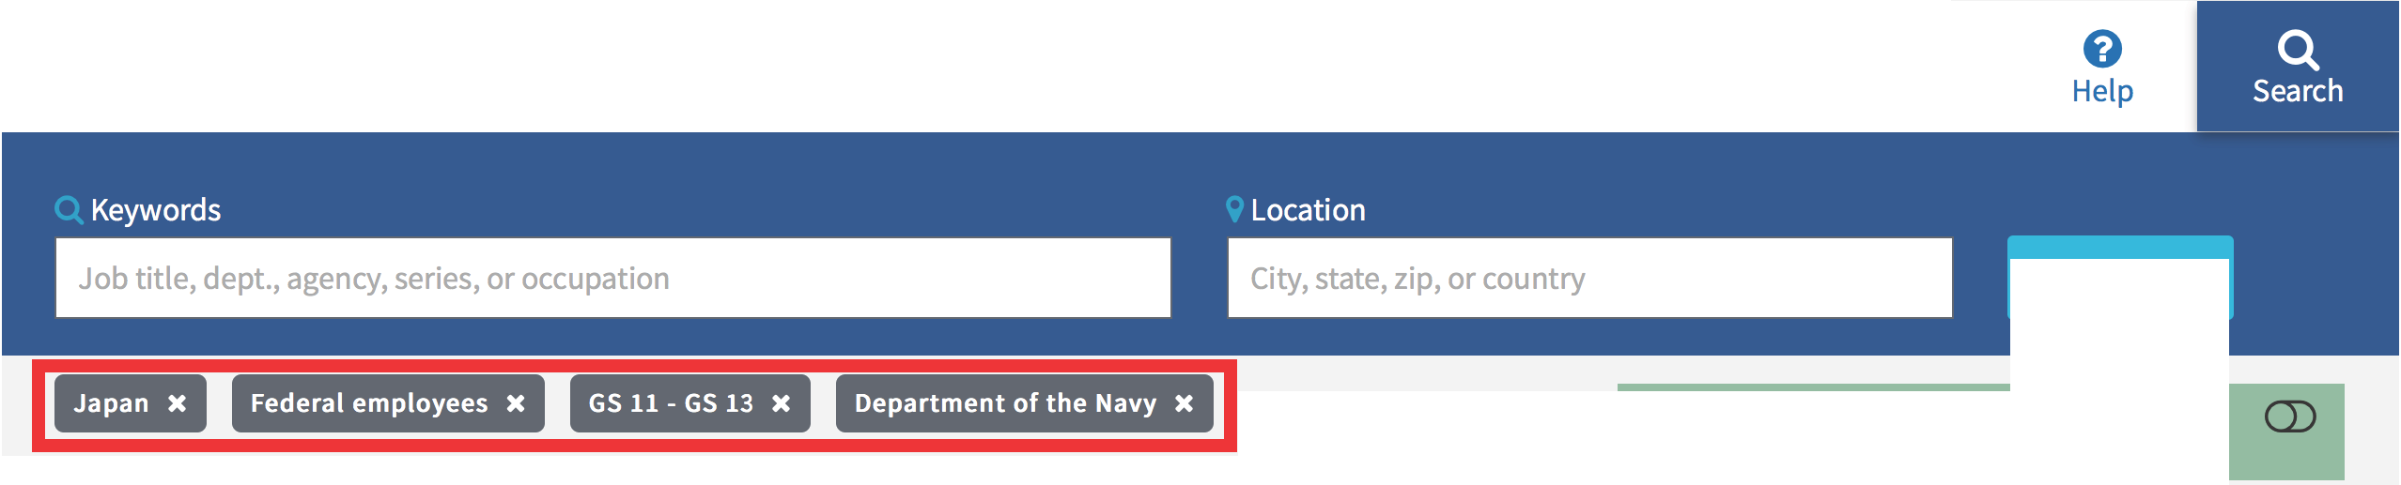


IB§ An official website of the United States government
:.
Brandi
USAJOBs·
Search
& You'renolonger usingfilters from your profile for thissearch.
X Remove all filters
IViewing 1- 10 of 16 jobs
I
Sort by I Relevance v
Top filters
More filters
"Save this search. We'll emailyou newjobs as they become available.
Hiring path
9Help
GENERAL ENGINEER
U.S.Pacific Fleet, Commander in Chief Department of the Navy
9Yokosuka, Japan
'<C:l Save Job
0 a Open to the public (25)
Starting at $64,813 (GS 12)
Permanent • Full-Time
a fi Federal employees (16)
0 e Internal to an agency (6)
O G Veterans (15)
0 Q Individuals with disabilities (1)
0 S Military spouses (16)
Show ORtions with O jobs
0 Open 08/01/2017 to 08/15/2017
NEW PARENT SUPPORT SPECIALIST
Commander, Navy Installations Department of the Navy
9 Sasebo, Japan
'<C:l Save Job
Starting at $52,329 (GS 11) Permanent • Full-Time

Slide 55

Open & closing dates
02017-08-01to 2017-08-15
Salary
$64,813 to $83,632 I per year
Pay scale & grade GS 12
Series
0801General Engineering
Appoi ntment type Permanent
Work schedule Full-Time
Job announcement number ST-10013388-17-GJ
Control number 475852400
Locations
1vacancy in the following location:
9 Yokosuka ,Japan

Slide 56
Job Overview
Summary
About the Agenq
The selectee for this position willserve as a General Engineer in the U.S. Naval Ship Repair Facility and Japan Regional Maintenance Center (SRF-JRMC), Yokosuka, Japan of NAVAL SHIP REPAIR FACILITY.
To learn more about the living and workingcondition at this military installation go to: http:,_LLwww.militaryinstallations.dod.milLMOSLf?P-=Ml :ENTRY:O
"Welcome to the Pacific" magazine link:httP-s:LLeP-ub.striP-es comLWelcome-to-Pacific-JO. 1 2081 6
Priority consideration willbe given to military spouse preference and family member preference eligible residing inthe commute area of the duty location for this position.Commute area is defined as the geographic area surroundingthe duty location in which people can reasonably be expected to travel back and forth daily.
Military Spouses and Family Members may apply 30 days before their anticipated arrival date. However, they willnot receive preference until arrival at the foreign location.Additional documentation may be required prior to granting preference.
Military spouses and family members who are appointed may not extend longer than 2 months following the transfer of the sponsor from the commuting area of the foreign duty station;2 months beyond the separation of the appointee's sponsor; or any time beyond the time employee ceases to be a family member.

Slide 57
Duties
The successful selectee willperform the followingduties:
Prepares welding procedures,welding procedure qualification reports, correspondence,investigation reports, technical reports,status reports, and schedules as required to complete project assignments under the direction of the QA Director.
Provides informational and consultingservices to shipyard functions concerned with welding and allied processes in order to resolve difficult and complex unforeseen problems. Includes input or responses to Deficiency Reports related to weldingissues.
Supports the QA Director at shipyard and off station meetings and conferences with counterparts and top operating personnel at NAVSEA, NAVSESS, NSY's, other Regional Maintenance Centers (RMC's), private shipyards,contractor and other officials in similar or related work as required.
Provides guidance,coachingand mentoringto the Division senior MLC managers in support of the resolution of complex and conflicting interests relative to the efficient operation of the Division and optimum use of manpower.
Provides trainingto new weldingengineers and weldingtechnicians as required.
Supervisory Status
No
Promotion Potential
12
Travel Required
Occasional Travel
Travel is dependent upon position description and availability of funding.
Relocation Authorized
Yes
Relocation expenses i.e.PCS or relocation incentives as described in 5 USC 5753 may be authorized in accordance with applicable travel regulations,command policy and available command funding.

Slide 58
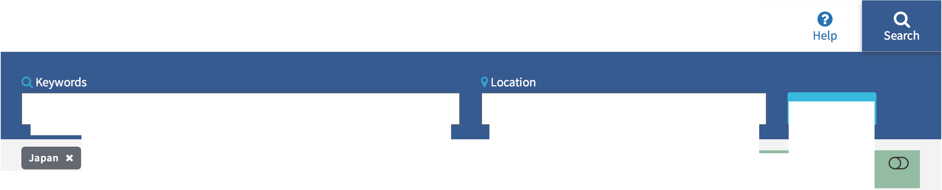
IB§ An official website of the United States government
:.
Brandi
USAJOBs·
Job title, dept.,agency,series, or occupation
City, state, zip, or country
Search
Federal employees x
GS 11- GS 13 X Department of the Navy X
Viewing 1 - 10 of 1 6 jobs *
& You're nolonger usingfilters from your profile for thissearch.
X Remove all filters
Sort by I Relevance v
Top filters
More filters
"Save this search. We'll emailyou newjobs as they become available.
Hiring path
9Help
GENERAL ENGINEER
U.S.Pacific Fleet, Commander in Chief Department of the Navy
9Yokosuka, Japan
'<C:l Save Job
0 a Open to the public (25)
Starting at $64,813 (GS 12)
Permanent • Full-Time
a fi Federal employees (16)
0 e Internal to an agency (6)
O G Veterans (15)
0 Q Individuals with disabilities (1)
0 S Military spouses (16)
Show ORtions with O jobs
0 Open 08/01/2017 to 08/15/2017
NEW PARENT SUPPORT SPECIALIST
Commander, Navy Installations Department of the Navy
9 Sasebo, Japan
'<C:l Save Job
Starting at $52,329 (GS 11) Permanent • Full-Time

Slide 59


..
USAJOBs·
:.
9
Help
Brandi
Keywords
Location
Federal employees
IC
Department of the Navy IC
0801 - General Engineering
X
0802 - Engineering Technical
IC
& You're nolonger usingfilters from your profilefor this search.
0803 - Safety Engineering IC
0804 - Fire Protection Engineering x
0806 - Materials Engineering IC
0807 - Landscape Architecture
IC
0808 - Architecture
IC
0809 - Construction Control Technical
IC
0810 - Civil Engineering IC
0817 - Survey Technical
IC
Series
X
OHelp
0819 - Environmental Engineering X
0828 - Construction Analyst
IC
0830 - Mechanical Engineering IC
0840 - Nuclear Engineering IC
Jump to
IC Remove allfilters
0000 | 0100 | 0200 | 0300 | 0400 | 0500 | 0600 | 0700 | 0800 | 0900
1000 | 1100 | 1200 | 1300 | 1400 | 1500 | 1600 | 1700 | 1800 | 1900
2000 | 2100 | 2200 | 2300 | 2500 | 2600 | 2800 | 3100 | 3300 | 3400
3500 | 3600 | 3700 | 3800 | 3900 | 4000 | 4100 | 4200 | 4300 | 4400
4600 | 4700 | 4800 | 5000 | 5200 | 5300 | 5400 | 5700 | 5800 | 6500
6600 | 6900 | 7000 | 7300 | 7400 | 7600 | 8200 | 8600 | 8800 | 9000
9900
0600
Viewing 1- 2 of 2 jobs
Sort by Relevance v
111111 Save this search.We'll email you newjobs as they become available.
Save search
Name Required
Engineer Jobs Japan
•Notification frequency
,/ Daily
Weekly Monthly
Never
0610 - Nurse (1)
Save Job
G:J
U.S. Pacific Fleet, Commander in Chief Department of the Navy
9Yokosuka ,Japan
Starting at $64,813 (GS 12)
Permanent • Full-Time
a 0801- GeneralEngineering (1)
a 0840 - Nuclear Engineering (1)
0 Open 08/01/2017 to 08/15/2017

Slide 60
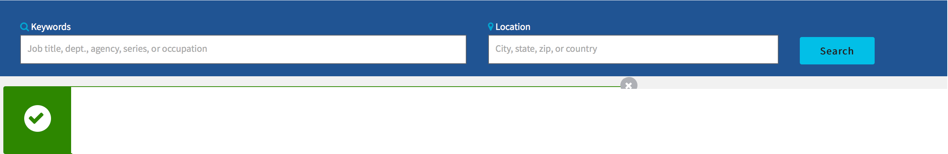

ii§ An officialwebsite of the United Statesgovernment
:.
Brandi
II
USAJOBs·
f)
Help
Saved Search
Your Engineer Jobs Japan search has beensaved.View Saved Searches
Series
X
6 Help
Jump to
Federal employees
X
Department of the Navy X
0801 - General Engineering X
0802 - Engineering Technical
X
0000 0100 0200 0300 0400 0500
0600
0700
0800
0900
 |  |  |  | 1000 | 1100 | 1200 | 1300 | 1400 | 1500 | 1600 | 1700 | 1800 | 1900
0803 - Safety Engineering | x 0804 - Fire Protection Engineering x | 0806 - Materials Engineering x | 0807 - Landscape Architecture X | 2000 | 2100 | 2200 | 2300 | 2500 | 2600 | 2800 | 3100 | 3300 | 3400
0808 - Architecture x | 0809 - Construction Control Technical x | 0810 - Civil Engineering x 0817 - | Survey Technical x | 3500 | 3600 | 3700 | 3800 | 3900 | 4000 | 4100 | 4200 | 4300 | 4400
 |  |  |  | 4600 | 4700 | 4800 | 5000 | 5200 | 5300 | 5400 | 5700 | 5800 | 6500
0819 - Environmental Engi | neering X 0828 - Construction Analyst X | 0830 - Mechanical Engineering X | 0840 - Nuclear Engineering X
Remove all filters |  |  |  | 6600 | 6900 | 7000 | 7300 | 7400 | 7600 | 8200 | 8600 | 8800 | 9000
 |  |  |  | 9900
X
Viewing 1- 2 of 2 jobs
Sort by
Relevance v
0800
1111 Saved search: Engineer Jobs Japan Edit saved search
a 0801- General Engineering (1)
a 0840 - Nuclear Engineering (1)
GENERAL ENGINEER
U.S.Pacific Fleet, Commander in Chief Department of the Navy
9Yokosuka, Japan
tr Save Job
Starting at $64,813 (GS 12) Permanent• Full-Time
1100
1102 - Contracting (1)
0 Open 08/01/2017 to 08/15/2017
NUCLEAR ENGINEER
tr Save Job
1800

Slide 61
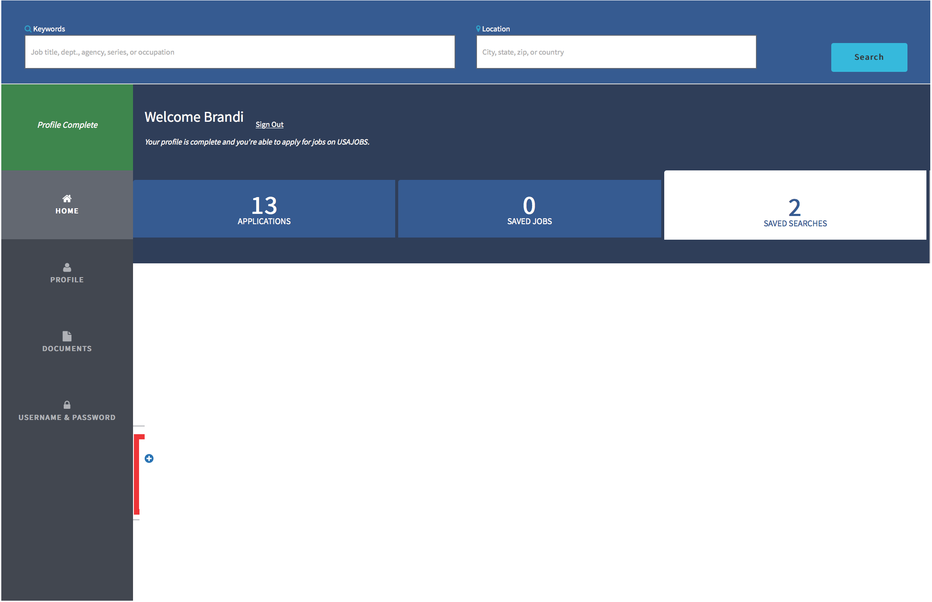
..
USAJOBs·
Brandi
€)
Help
Active
Archived
Sort by
Last updated
v
Engineer Jobs Japan
Alert: Daily
Created 8/15/2017
O HR Jobs Japan
Alert:Daily
Created 8/15/2017

Slide 62

Quick Tips
Must have a USA Jobs account to apply to competitive Federal positions
Use the resume builder in USA Jobs – this will provide the format with critical information that is used by OCHR to qualify resumes for positions ex. Time in grade, job series, etc.
Update your resume regularly – training, new skillset, details and temp assignments
Set search parameters and APPLY
How To on almost every topic https://www.usajobs.gov/Help/how-to/

Slide 63
“Overseas” Compensation
Post Allowance (PAL)
  For cost of living overseas
Living Quarters Allowance (LQA)
  Pays rent & utilities
Foreign Transfer Allowance (FTA)
  Temporary Lodging before you leave
Temporary Quarters Subsistence Allowance (TQSA)
  Until you find a house/apartment
Miscellaneous Expense Allowance
  Move-in expenses
And more…
Notes:
63
Mention no locality adjustment for working overseas
- Post Allowance (PAL)
For cost of living overseas
- Living Quarters Allowance (LQA)
Pays rent & utilities
- Foreign Transfer Allowance (FTA)
Temporary Lodging before you leave
- Temporary Quarters Subsistence Allowance (TQSA)
Until you find a house/apartment
- Miscellaneous Expense Allowance
Move-in expenses
- And more…
-----------------------------------------------------------------------
Good Benefits Package for overseas positions
Financial compensation for relocating to Japan
---------------------------------------------------
Relocation Incentive Bonus (Pay)
All positions may be eligible
Up to 25% of base pay per year for 3 years
Additional 25% years for extending
Dependent on position, i.e. criticality, difficulty to fill, etc

Slide 64
Additional Incentives
Shipment/storage of Household goods (HHG)
  Up to 18,000 lbs at government expense
Paid travel for qualified dependents in school
  One round trip to Japan per year
Entitled to 360 hours annual leave carryover
  Retainable after returning stateside
Home Leave – 5 days per year
  Used in the U.S. /territories only
Renewal Agreement Travel (RAT)
  Roundtrip travel to US for entire family
  After 1st tour/3 years upon extending 5 years
Notes:
Leave Benefits
Can carry over up to 360 hours/year
Allowed to retain on the books when you return stateside
Additional Home Leave available after 24-months of continuous service abroad
5 days earned each year
Property Management Services
Professional property fees may be paid to rent/lease and manage your home (command must authorize)
Up to 10% of rent amount

Slide 65
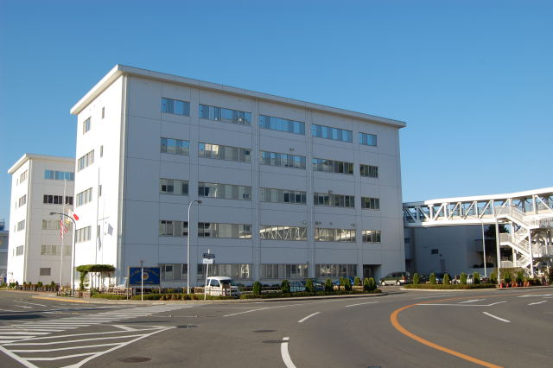
SRF Headquarters Yokosuka

Slide 66
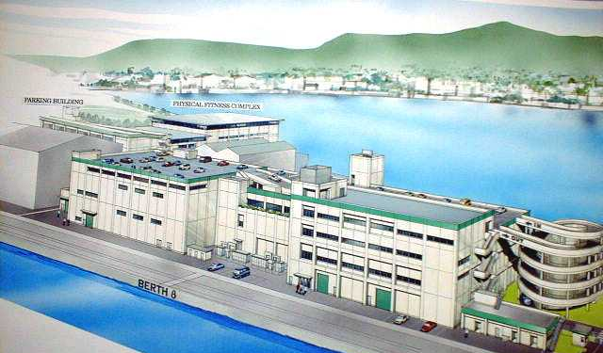
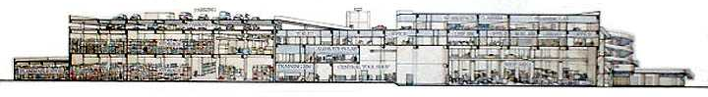
Sasebo Ship Support Complex
Phase II-ECD FY10
Phase I-Completed FY06

